Slide 1

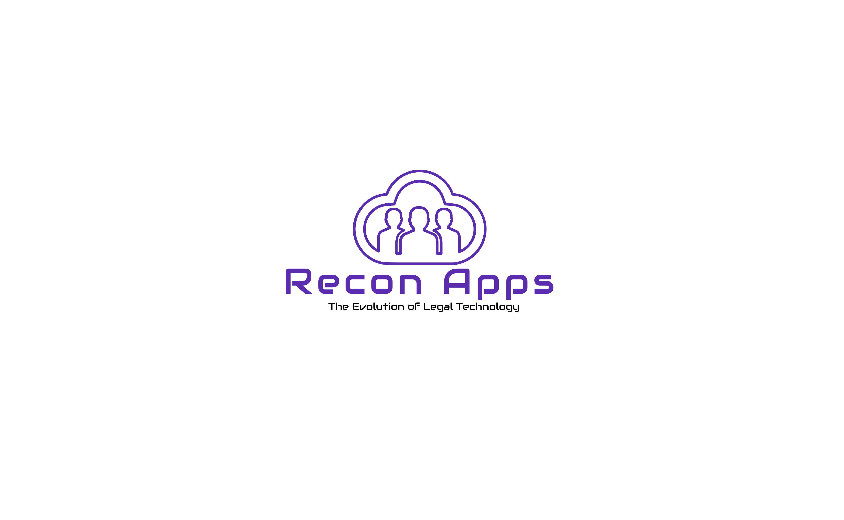
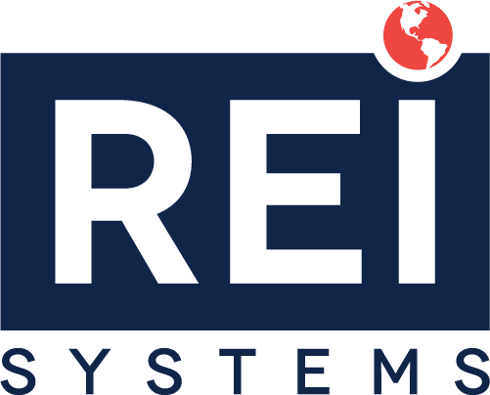

Demonstration to Department of Justice/Civil Rights Division for CRT Case Management
RFQ No. 15JPSS23Q00000081
August 25th, 2023

Slide 2
Team Stealth Introduction Experienced in Salesforce-based COTS solutions (Case, Grants, Contact Management) for government sector.
Rahul Sundrani, President (Stealth Solutions)
Vishnu Devarashetty , Proposed Project Manager (Stealth Solutions)
Akeem Shane, Proposed Technical Lead (REI Systems)
Tom Mavis, Legal Case Management SME, (Recon Apps)
Nambi Raghupathy, Salesforce Practice Lead (Stealth Solutions)
Team Stealth unifies top-tier solutions and resources to provide the optimum service for DOJ.
Notes:
Stealth Solutions, Inc. (Stealth) is a certified 8a small business and trusted Salesforce partner. Our expertise involves customizing applications such as Case Management, Grants Management, Contact Management, and Learning Management on the Salesforce Platform. We cater to diverse needs in government and non-profit sectors.
Our valued partner, REI Systems, has been a trusted Federal contractor for 20+ years and a Salesforce ISV partner since 2008. With 700+ staff in the National Capital Region, REI serves cabinet-level departments and is recognized as a top 5 Salesforce implementation partner in the public sector.
Salesforce is the global leader in offering a highly secure Government Cloud Platform as a Service (PaaS) solution. This empowers seamless collaboration between business and technology, enabling the prompt delivery of exceptional customer experiences.
Recon Apps develops the ReconELM App, a specialized legal case and matter management (COTS) application on the Salesforce platform, tailored for government agency attorneys.

Slide 3
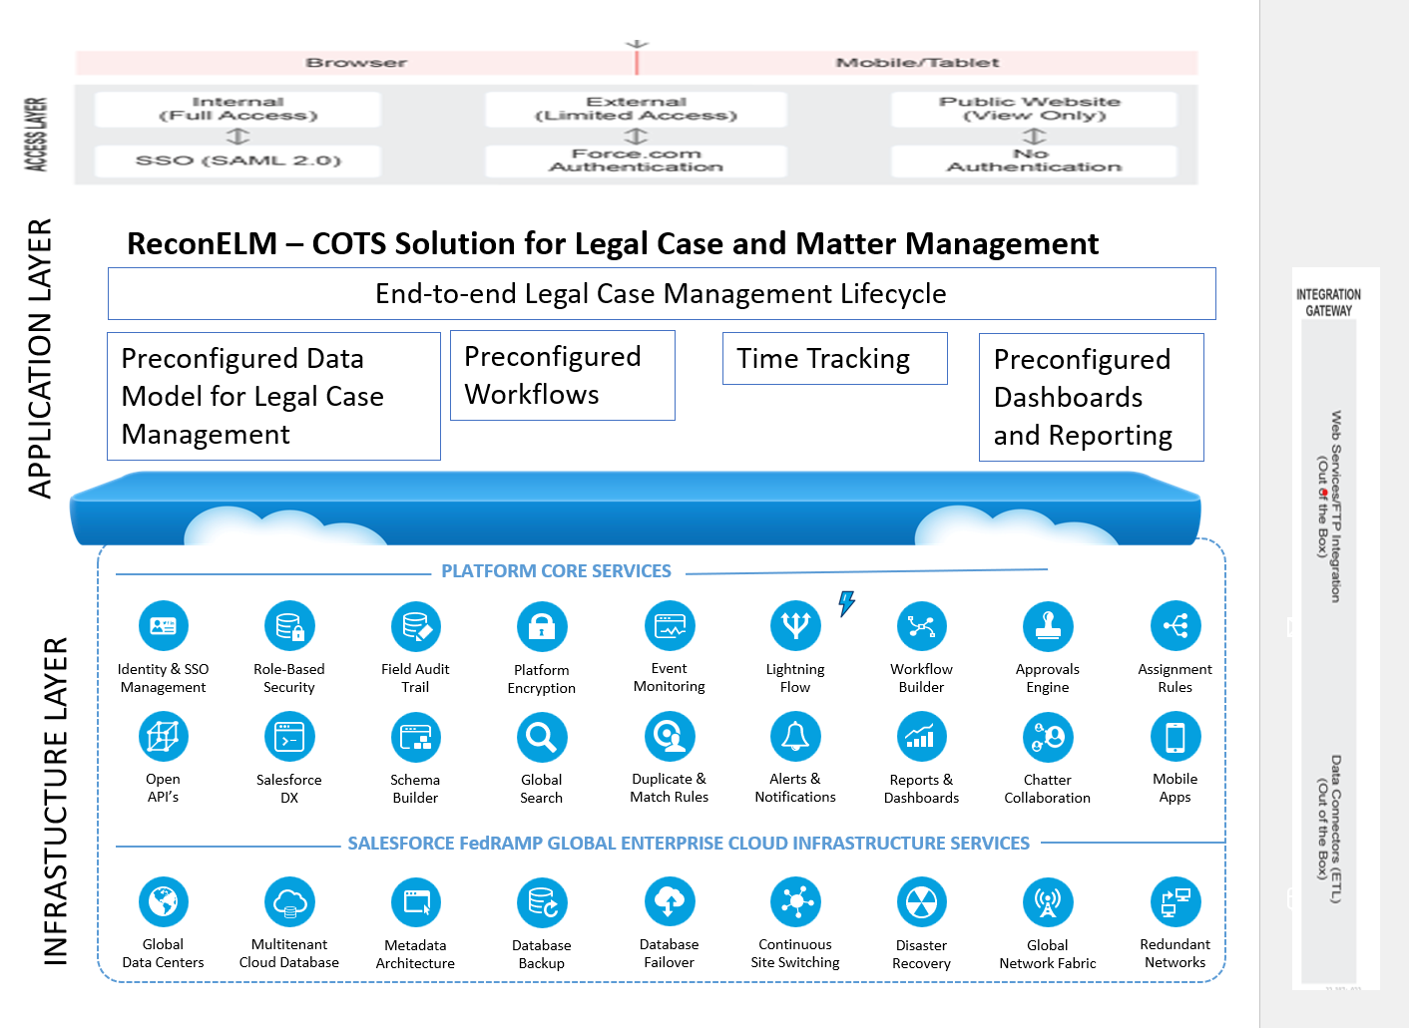
Solution Overview is natively designed, developed, and hosted on the Salesforce platform.
Platform (Salesforce)
Hosted on Salesforce's FedRAMP-certified Government Cloud
Highly scalable, extensible, and easily deployable
Offers native support for System-to-System Integration and Data Migration
Provides built-in APIs for seamless integration
COTS Legal and Case Management Application (ReconELM):
Encompasses full legal matter lifecycle, from intake to resolution
Incorporates robust constructs: Matter, Intakes, Time Reporting
Offers powerful Business Intelligence and Automated Reporting
Highly configurable, driven by a configurability-first approach
Updated Graphic Pending!
Proposed Solution is architected to support current and future DOJ needs
Notes:
Akeem, direct your attention to the diagram on the right and follow the bottom-up approach as you explain the key highlights:
Bottom Infrastructure Layer: The Salesforce Government Cloud Plus serves as a FedRamp High Infrastructure, featuring redundant data centers and networks. It ensures continuous data backup, real-time disaster recovery, and seamless switching.
Layer 2 (Platform Services): This layer encompasses essential services such as Single Sign-On, Encryption, Role-Based Security, and robust auditing. It also offers valuable tools like Workflow Engine, Approval Engine, Open APIs, Schema Builder, powerful Search capabilities, and Reporting and Dashboarding features.
Layer 3 (COTS Legal Application - ReconELM): ReconELM, our Legal Case and Matter Management solution, handles the complete case lifecycle. It comes preconfigured with a data model, workflow time tracking, and reporting tailored for the legal domain. Our swift deployment leverages ReconELM's configurability prowess.
Top Layer (Access Layer): This top layer ensures seamless access from both Desktop and Mobile devices, providing convenient accessibility for users.
Below is just additional reference material.
Salesforce Platform Advantage: Harnessing Salesforce offers inherent security, scalability, and reliability, aligning with the rigorous data protection needs of agencies like the DOJ. The platform's powerful architecture, global search, flexible data sharing, seamless integration, and efficient data management ensure optimal growth, controlled access, cohesive workflows, and streamlined data handling.
ReconELM COTS Application Advantages: ReconELM, a versatile COTS solution, is preconfigured for Attorneys and Government Support Staff, incorporating essential data models, workflows, reports, and automation. Key features are:
Tailored to Legal Professionals
Full Legal Case Management Lifecycle Support:
Robust Reporting: flexible reporting module that allows users to generate detailed reports and perform in-depth analysis.
Configurability: ReconELM’ s design promotes configurability, enabling organizations to tailor the system to their specific needs without resorting to extensive customizations. This approach reduces implementation time and effort.

Slide 4
Live Demonstration of Legal Case Management Solution

Slide 5
DOJ CRT ICM Demonstration Checklist
General (G)Requirements
Case Management (CM) Requirements
Timekeeping (T) Requirements
Reporting (R) Requirements
Administration (A) Requirements

Slide 6
DOJ CRT ICM Demonstration Checklist Conclusion
General (G)Requirements
Case Management (CM) Requirements
Timekeeping (T) Requirements
Reporting (R) Requirements
Administration (A) Requirements

